Slide 1
ARCHITECTURE-ADAPTIVE CODE VARIANT TUNING
Saurav Muralidharan
Amit Roy
Mary Hall
Michael Garland*
Piyush Rai**
University of Utah, *NVIDIA Research, and **IIT Kanpur

Slide 2
Introduction
Some computations may have multiple implementations, or code variants
E.g., different algorithms, data representations, parallelization strategies, etc.
Performance may depend on execution context (input and architecture characteristics)
Current autotuning systems can handle input-sensitivity
What about architecture sensitivity?
Training Inputs
Labeled Training Data
Variant 1
Variant 2
Exhaustive Search
Learning
Model

Slide 3
Motivation

Slide 4
Architecture-Adaptive Tuning
Given:
Set of source architectures and a target architecture
Labeled training data on source architectures
Device features characterizing both source and target
Goal: Build a code variant selection model on target architecture
Constraint: No training data collection on target architecture
Source Architectures
Training Data
Device Features
????
Target Model
Offline
Runtime
Input
Target Device Features
Model Query
Selected Variant
Target Model

Slide 5
Multi-Task Learning
Learn various tasks simultaneously to capture intrinsic relatedness among tasks
Approach: Treat each architecture as a task and perform feature vector concatenation
Source Architectures
Final Training Data
Training Data (T)
T_{SOURCE1}
DF_{SOURCE1}
Device Features (DF)
T_{SOURCE2}
DF_{SOURCE2}
Target Model
.
.
.

Slide 6
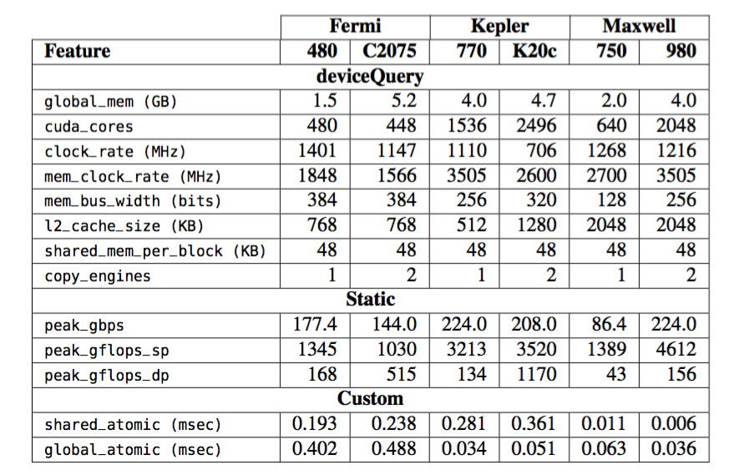
Device Features
Obtained via deviceQuery, published specifications (static), or micro-benchmarks (custom)

Slide 7
Profile Device Feature Selection
Idea: Use profiling data
Develop model for application proxies on source
Relate proxy to computation to find relevant device features
Application proxies
Each of the 5 proxies is a small application
Stresses a separate set of hardware components
For intensity X, produce roughly X% instructions of particular kind
SP-FLOP - 40%
// 6 loads and stores,
// 4 floating-point instructions
A[i] = A[i+1]*beta + alpha;
A[i+1] = A[i+2]*beta + alpha;
A[i+2] = A[i+3];

Slide 8
Profile Device Feature Selection
For each proxy, build a model that maps from profiling metrics of the proxy to intensity
Use the models to predict relevant hardware components and associated device features
Profiling Data
SP-FLOP @ 20%
Application Profiling Data
SP-FLOP @ 40%
Proxy Models
SP-FLOP @ 60%
SP-FLOP
DP-FLOP
MEM-BW
ATOMIC
SHMEM-BW
MEM-BW
ATOMIC
SP-FLOP @ 80%
SP-FLOP @ 100%
global_atomic, shared_atomic, peak_gbps, mem_clock_rate, mem_bus_width, l2_cache_size
SP-FLOP Model

Slide 9
Cross Validation Device Feature Selection
Perform multi-task learning on the source architectures alone to find the best device features
Relies on assumption that good device features on sources are good on target for same computation
SOURCE 1
global_atomic, shared_atomic, peak_gbps
TEMP TARGET
SOURCE 2
shared_atomic, peak_gbps
TEMP TARGET
TEMP TARGET
shared_atomic, mem_clock_rate
SOURCE 3
shared_atomic, peak_gbps
TEMP TARGET
SOURCE 4
global_atomic, shared_atomic
SOURCE 5
shared_atomic, peak_gbps, mem_clock_rate
TEMP TARGET
TARGET

Slide 10
Methodology
Six NVIDIA GPUs used:
Fermi generation: GeForce GTX 480, Tesla C2075
Kepler generation: GeForce GTX 770, Tesla K20c
Maxwell generation: GeForce 750 Ti, GeForce GTX 980
CPU: Intel Core i7-4770
CUDA Toolkit 6.5
Profiling metrics normalized w.r.t. total issued instructions
Training and test inputs taken from standard sets
Training and test sets are distinct
Test set much larger than training set to test generalization

Slide 11
Benchmarks
Benchmark | Variants
Histogram (CUB) | (Sort, Global-Atomic, Shared-Atomic) Variants, (Even-Share, Dynamic) Grid Mappings
SpMV (CUSP) | CSR Scalar, CSR Vector, ELL, DIA
GPU Sort (CUB, ModernGPU) | Merge, Locality, Radix
BFS (Back40Computing) | E-C (Fused/Iterative), C-E (Fused/Iterative), 2-Phase (Fused/Iterative)
Pre-Conditioner+Solver (CULA) | (CG, BiCGStab) Solvers (Jacobi, Blocked Jacobi, FAInv) Pre-conditioners
Transpose (Catanzaro et al.) | R2C, C2R, Skinny R2C/C2R
Input features specific to each benchmark; details in paper

Slide 12
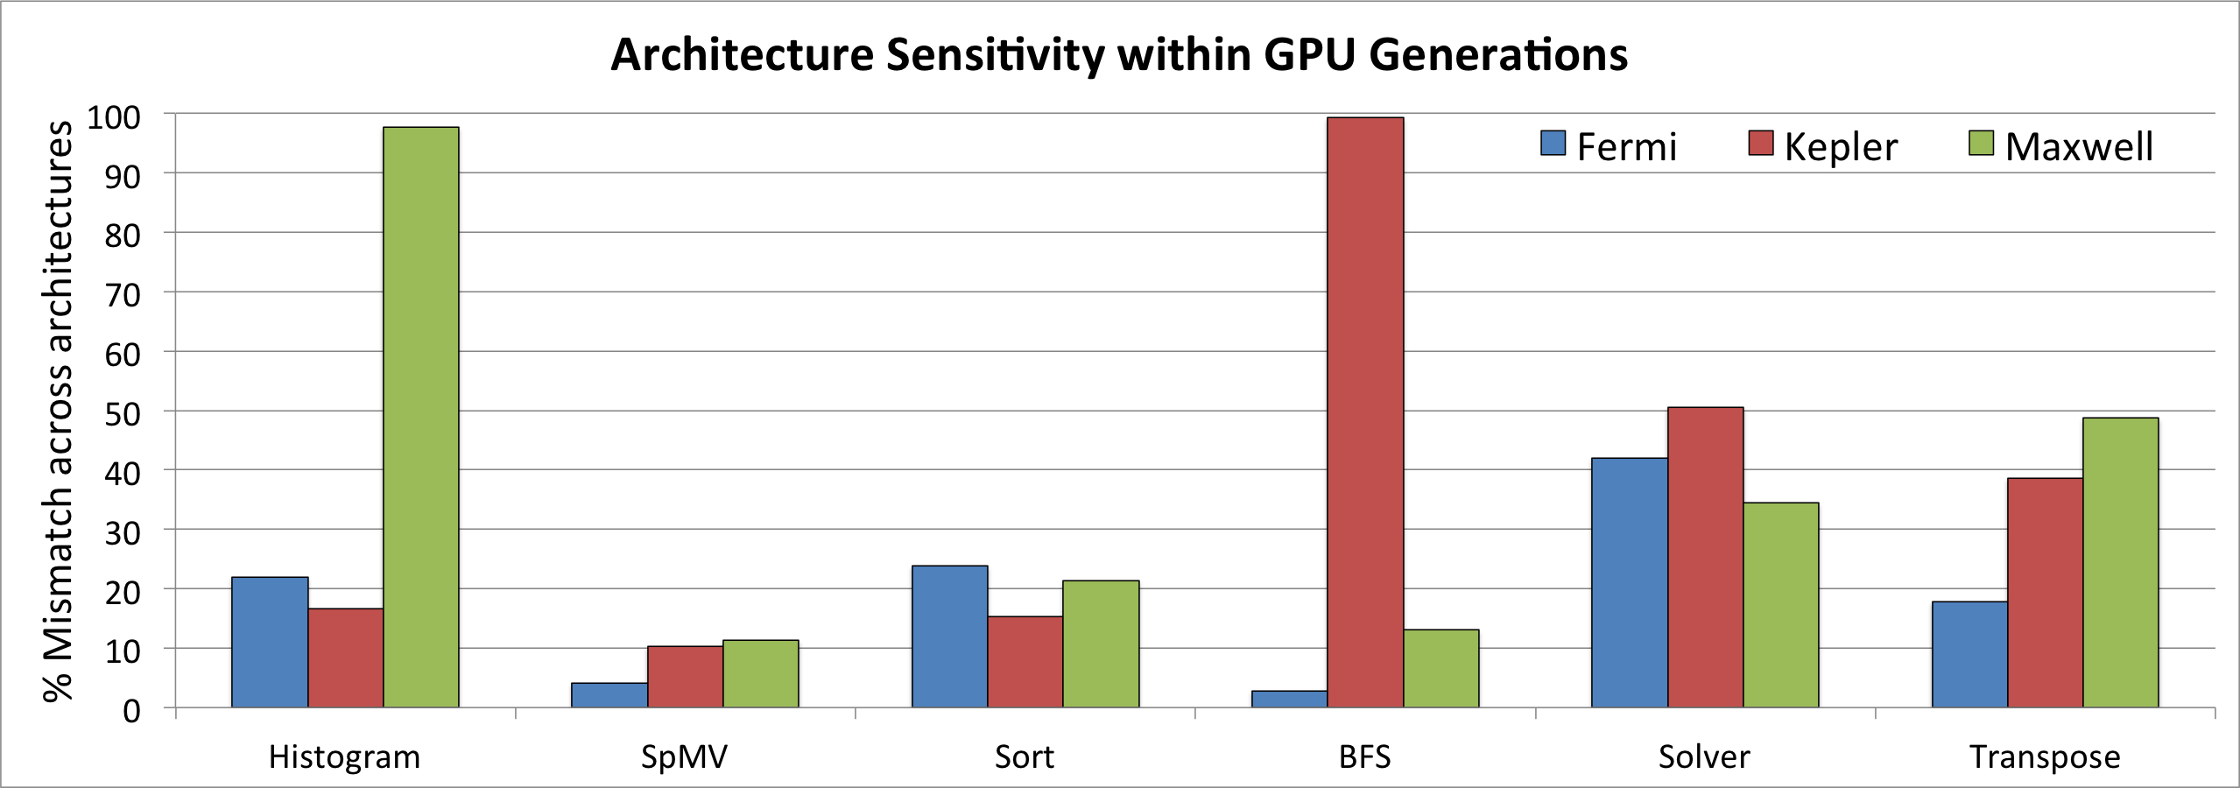
Architecture Sensitivity
Computations exhibit varying degrees of architecture sensitivity
Same generation does not always exhibit similar performance characteristics

Slide 13
Prediction Performance
Comparable performance to fixed-architecture tuning

Slide 14
Restricted Source Architectures
Device feature selection makes the approach more robust with less training

Slide 15
Device Feature Selection Overhead
 | P-DFS (sec) | CV-DFS (sec)
Histogram | 4.70 | 100.50
SpMV | 3.36 | 12.42
GPU Sort | 4.14 | 56.61
BFS | 3.89 | 30.27
Solver | 4.59 | 36.80
Transpose | 4.26 | 48.24
Much faster than re-training!

Slide 16
Related Work
Learning from performance counters
Cavazos et al., Parello et al.
Input-adaptivity:
PetaBricks, Nitro, Ding et al. G-ADAPT
Cross-architecture tuning: Magni et al.
Parameter tuning systems:
Active Harmony, Orio, OpenTuner etc.
Domain-specific autotuners: OSKI, SPIRAL, etc.

Slide 17
Conclusions & Future Work
Novel approach to cross-architecture autotuning
Comparable results to fixed-architecture tuning for 6 benchmarks on 6 NVIDIA GPUs
Future work:
Learn on one set of resources and adapt to a different set
Tuning across architecture classes such as CPUs and GPUs

Slide 18
Thank You!

